Slide 1

EDA with SQL
EDA from our Dataset with SQL query and results

Slide 2
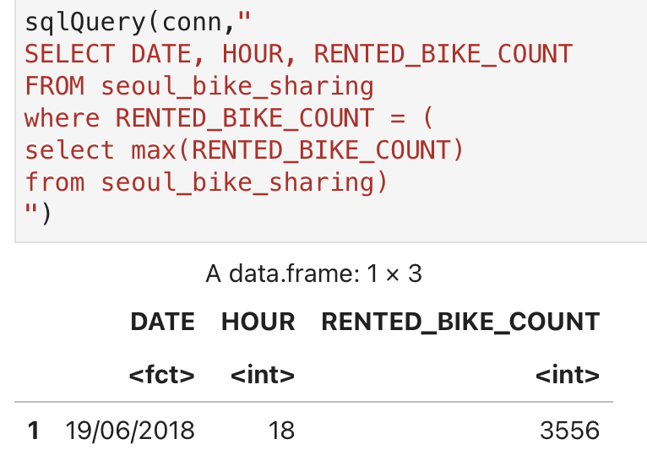
Busiest bike rental times
The busiest bike rental time was June 19th
6 pm was the busiest time
With around 3500 rentals across Seoul

Slide 3
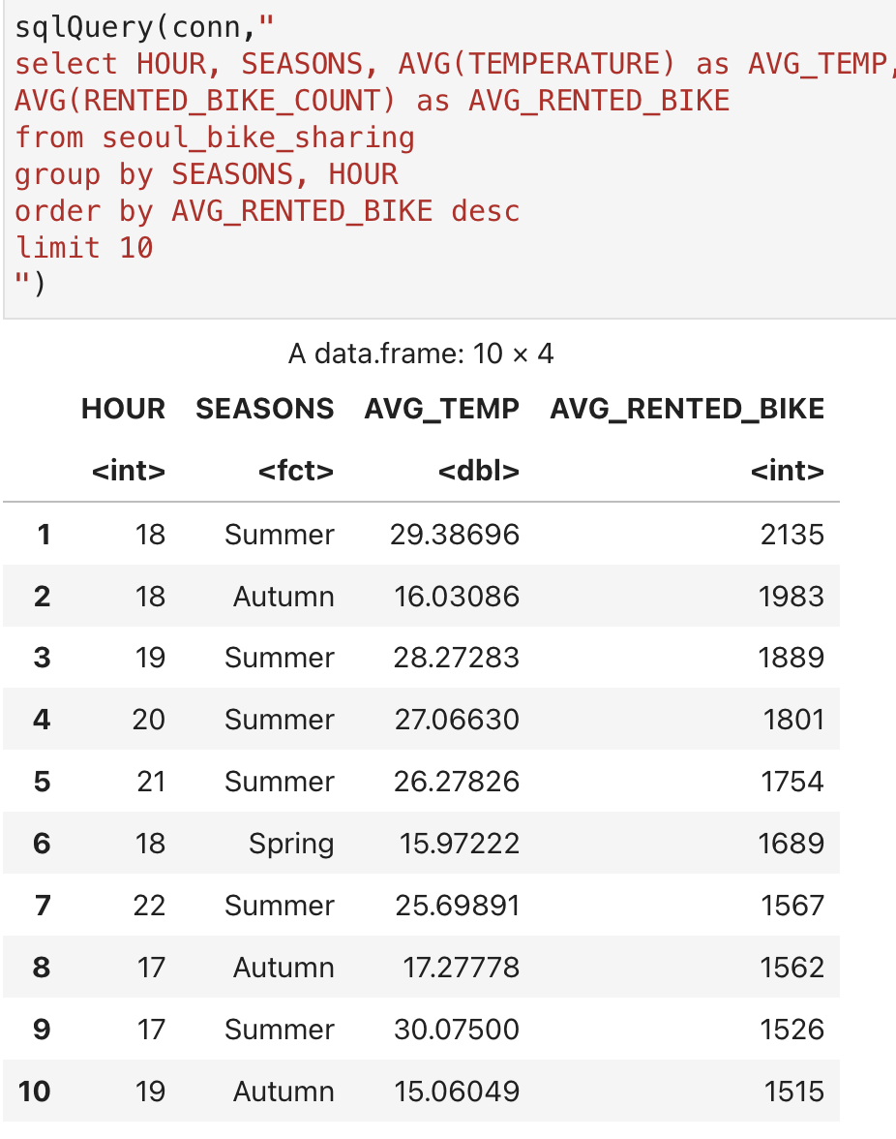
Hourly popularity and temperature by seasons
As you can see Autumn, Spring have similar bike rentals, and Summer has a higher more consolidated rental pattern while winter has a lower expected rental pattern.

Slide 4
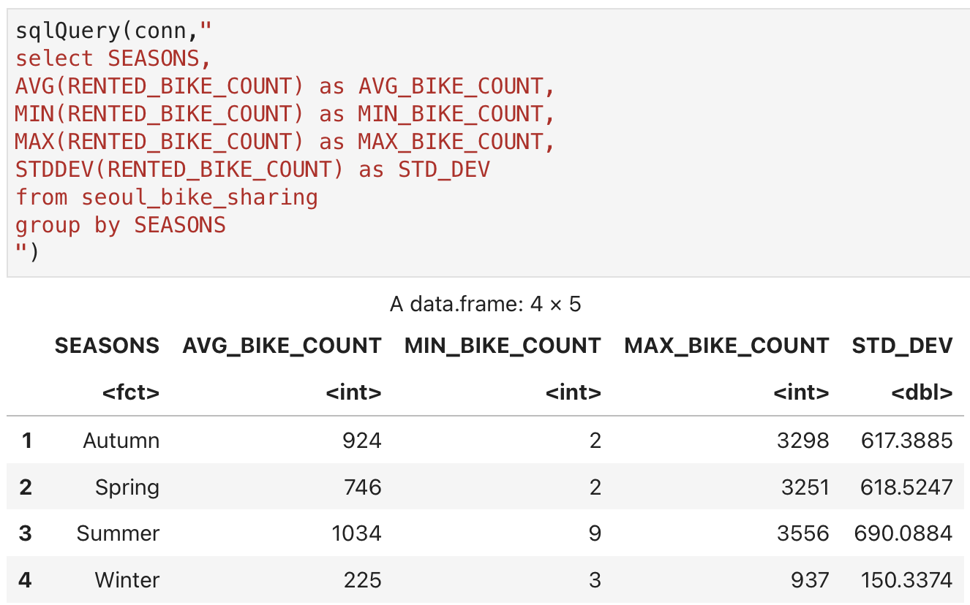
Rental Seasonality
From the output of our data you can see that summer and autumn have the highest average bike rental counts

Slide 5
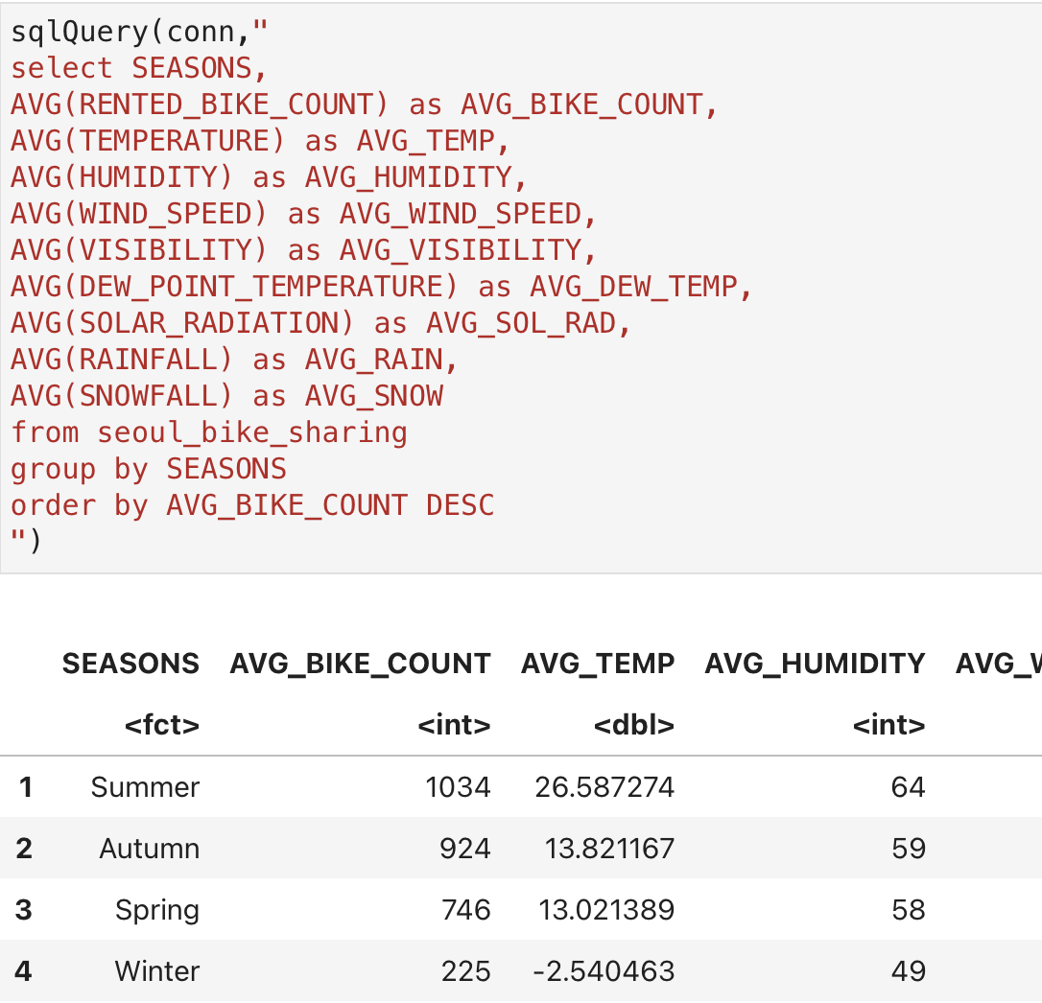
Weather Seasonality
From this SQL query, I was able to pull the average bike count as well as the average weather information for the selected seasons giving up a clear indication of averages across the 4 seasons.

Slide 6

EDA with Visualization
Visualizing our Results

Slide 7
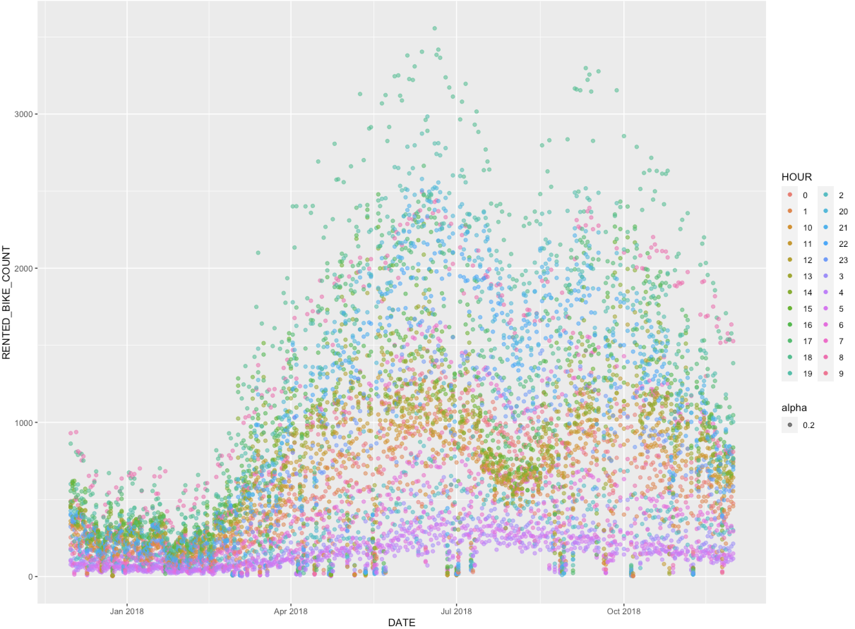
Bike rental vs. Date and Time
Plotted Data

Slide 8
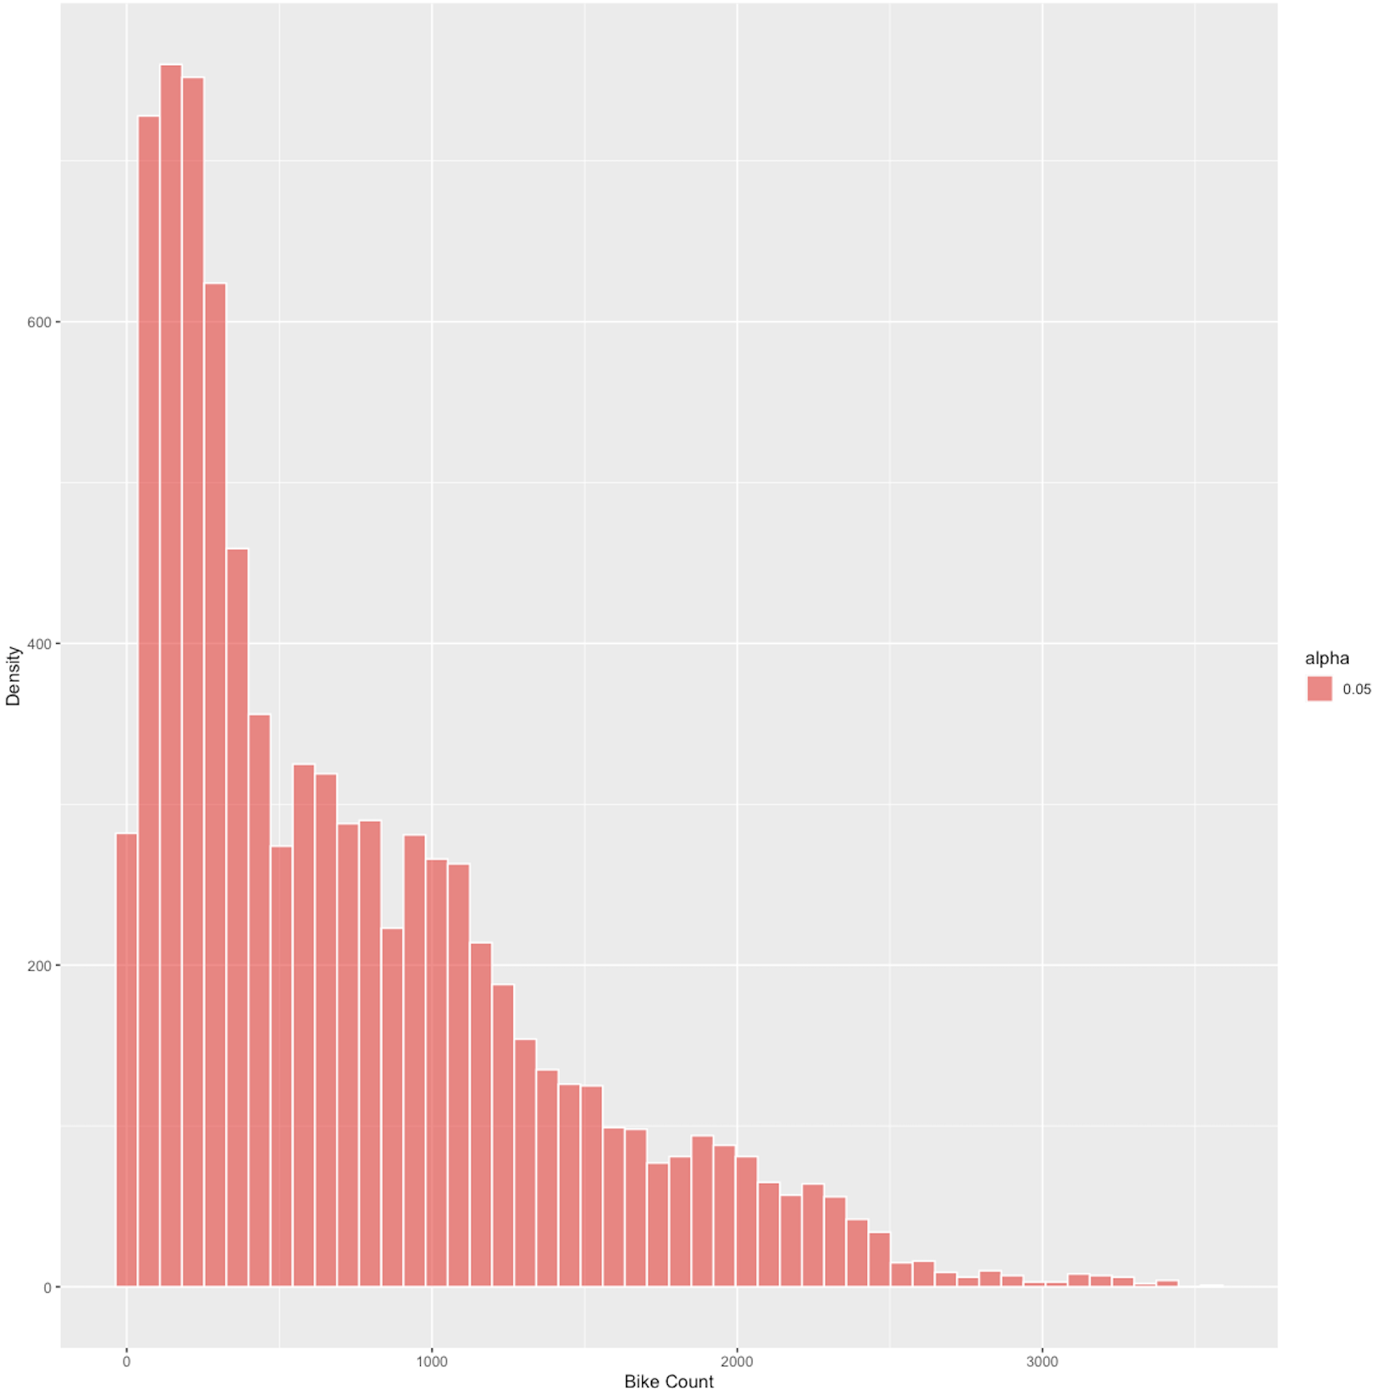
Bike rental histogram
Plotted Data

Slide 9
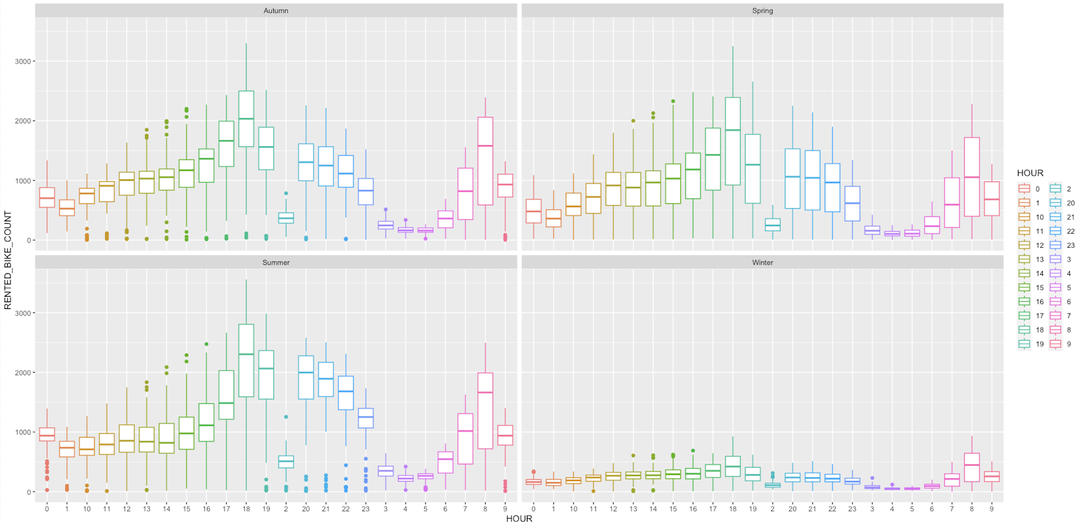
Seasonal bike rental count grouped by hour
Seasonality Box Plot, compared to hourly count of bike rentals

Slide 10

Predictive analysis
Using our data to make calculated predictions

Slide 11
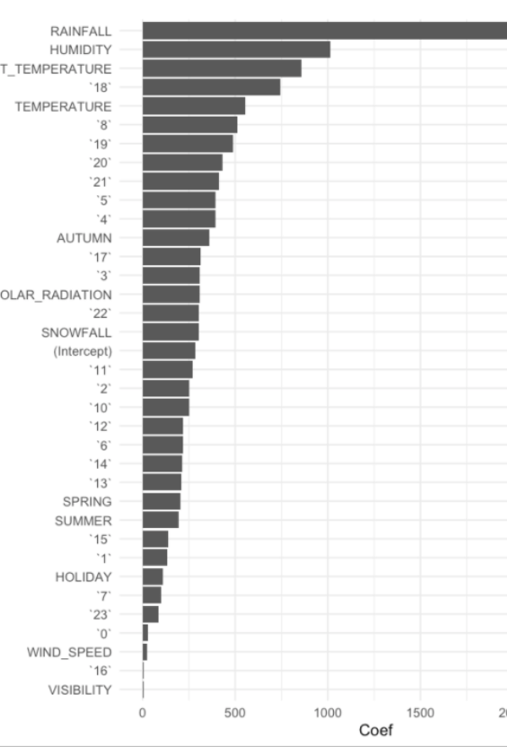
Ranked coefficients
With the ranked coefficients, you can visually see which variables have the biggest impact on determining the demand for bike-sharing rentals.
From our bar chart you can see Rainfall, Humidity, and Temperature are among the top influencing factors on determining demand.

Slide 12
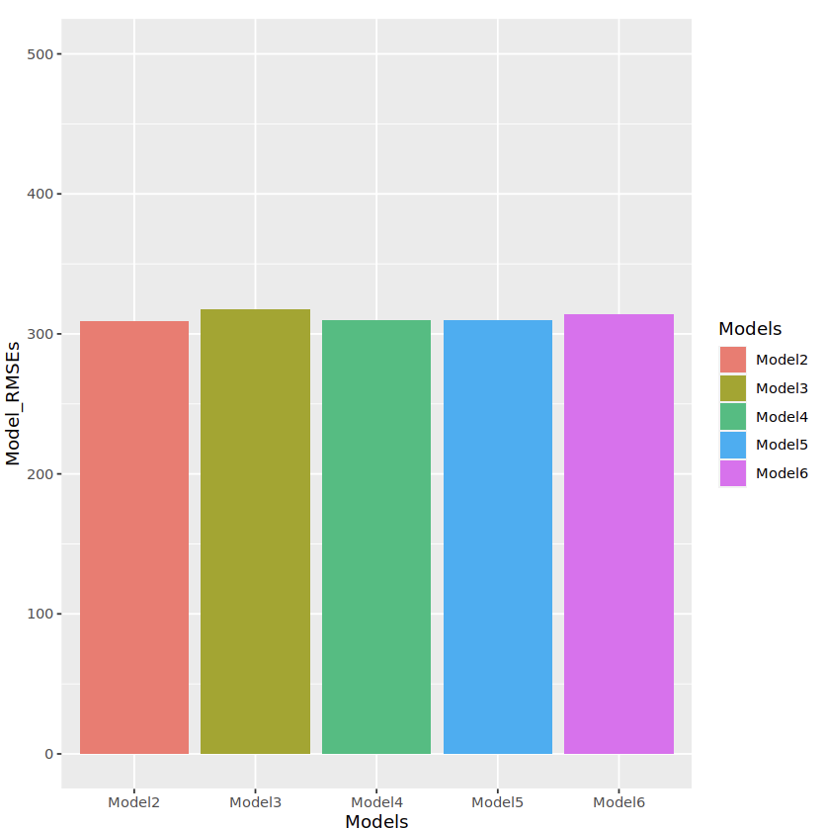
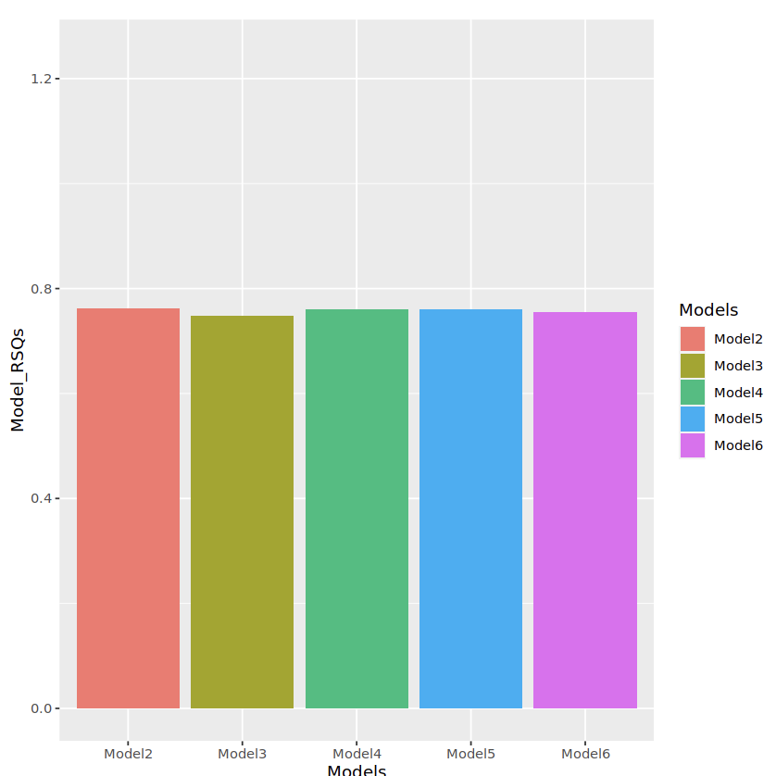
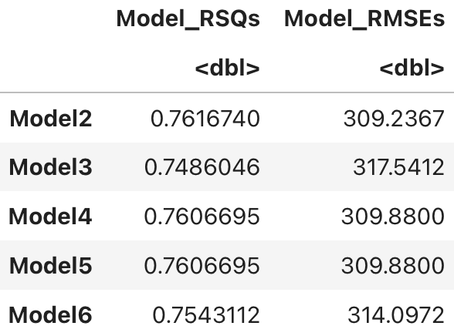
Model evaluation
5 Models built with different polynomials etc.… Model 2 has the highest RSQ and lowest RMSE

Slide 13
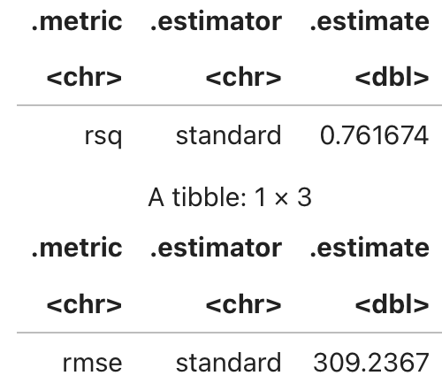
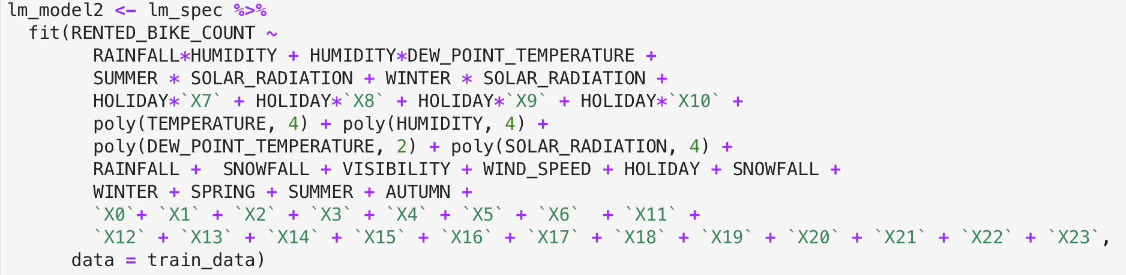
Find the best performing model
Select the best performing model with:
RMSE must be less than 330
R-squared must be larger than 0.72

Slide 14
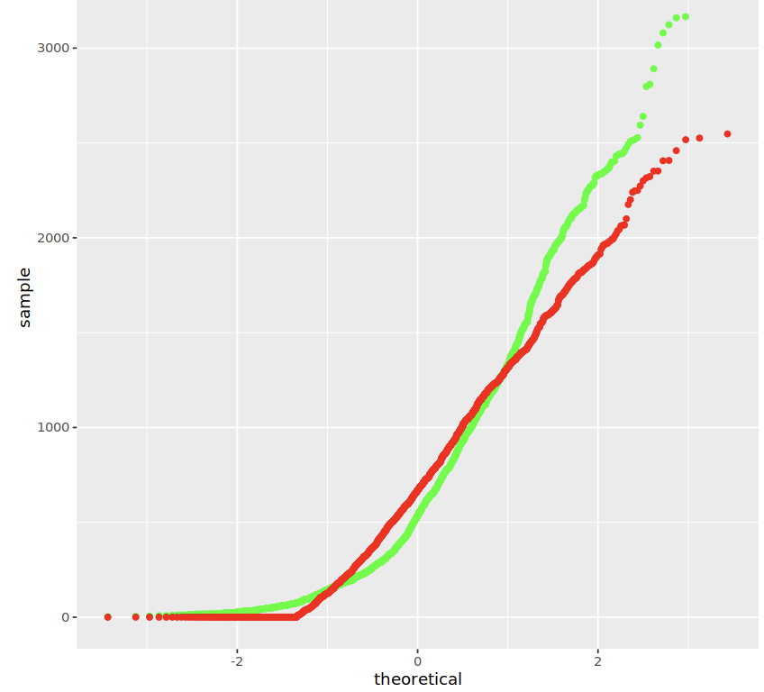
Q-Q plot of the best model
The Green Line represents the Test Data
The Red Line represents the Predicated Values
As you can see, the Model accurately stays along the True line of the data
This makes sure we are avoiding overfitting or underfitting the training data, ensuring we have optimal predictions.

Slide 15

Dashboard
Shiny Dashboard
Link to Shiny App

Slide 16
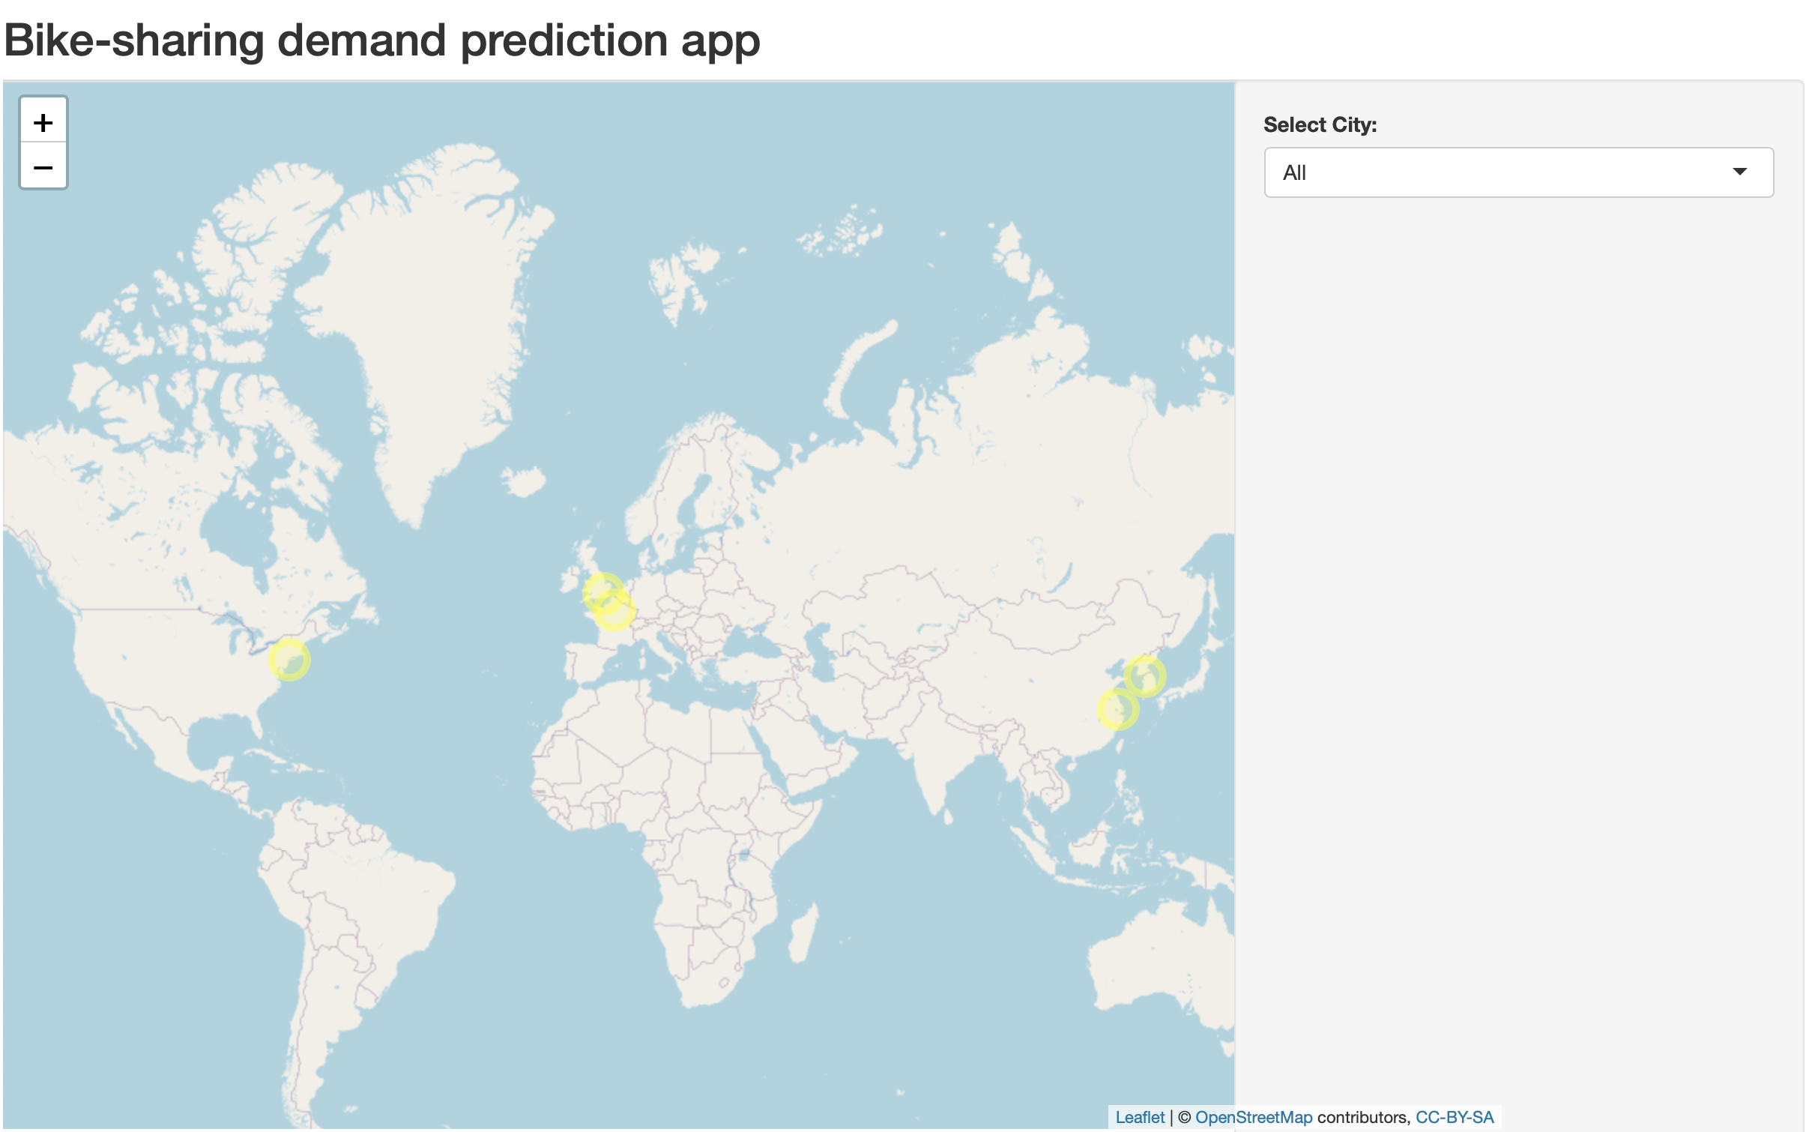
Bike-sharing Demand Prediction App
On the left is the main screen that you will see when you first open the Prediction app.
On the left side of the screen is an interactive map highlighting the cities you can click on for further information.
On the right of the screen is a drop-down list of the cities that we can make demand predictions for.

Slide 17
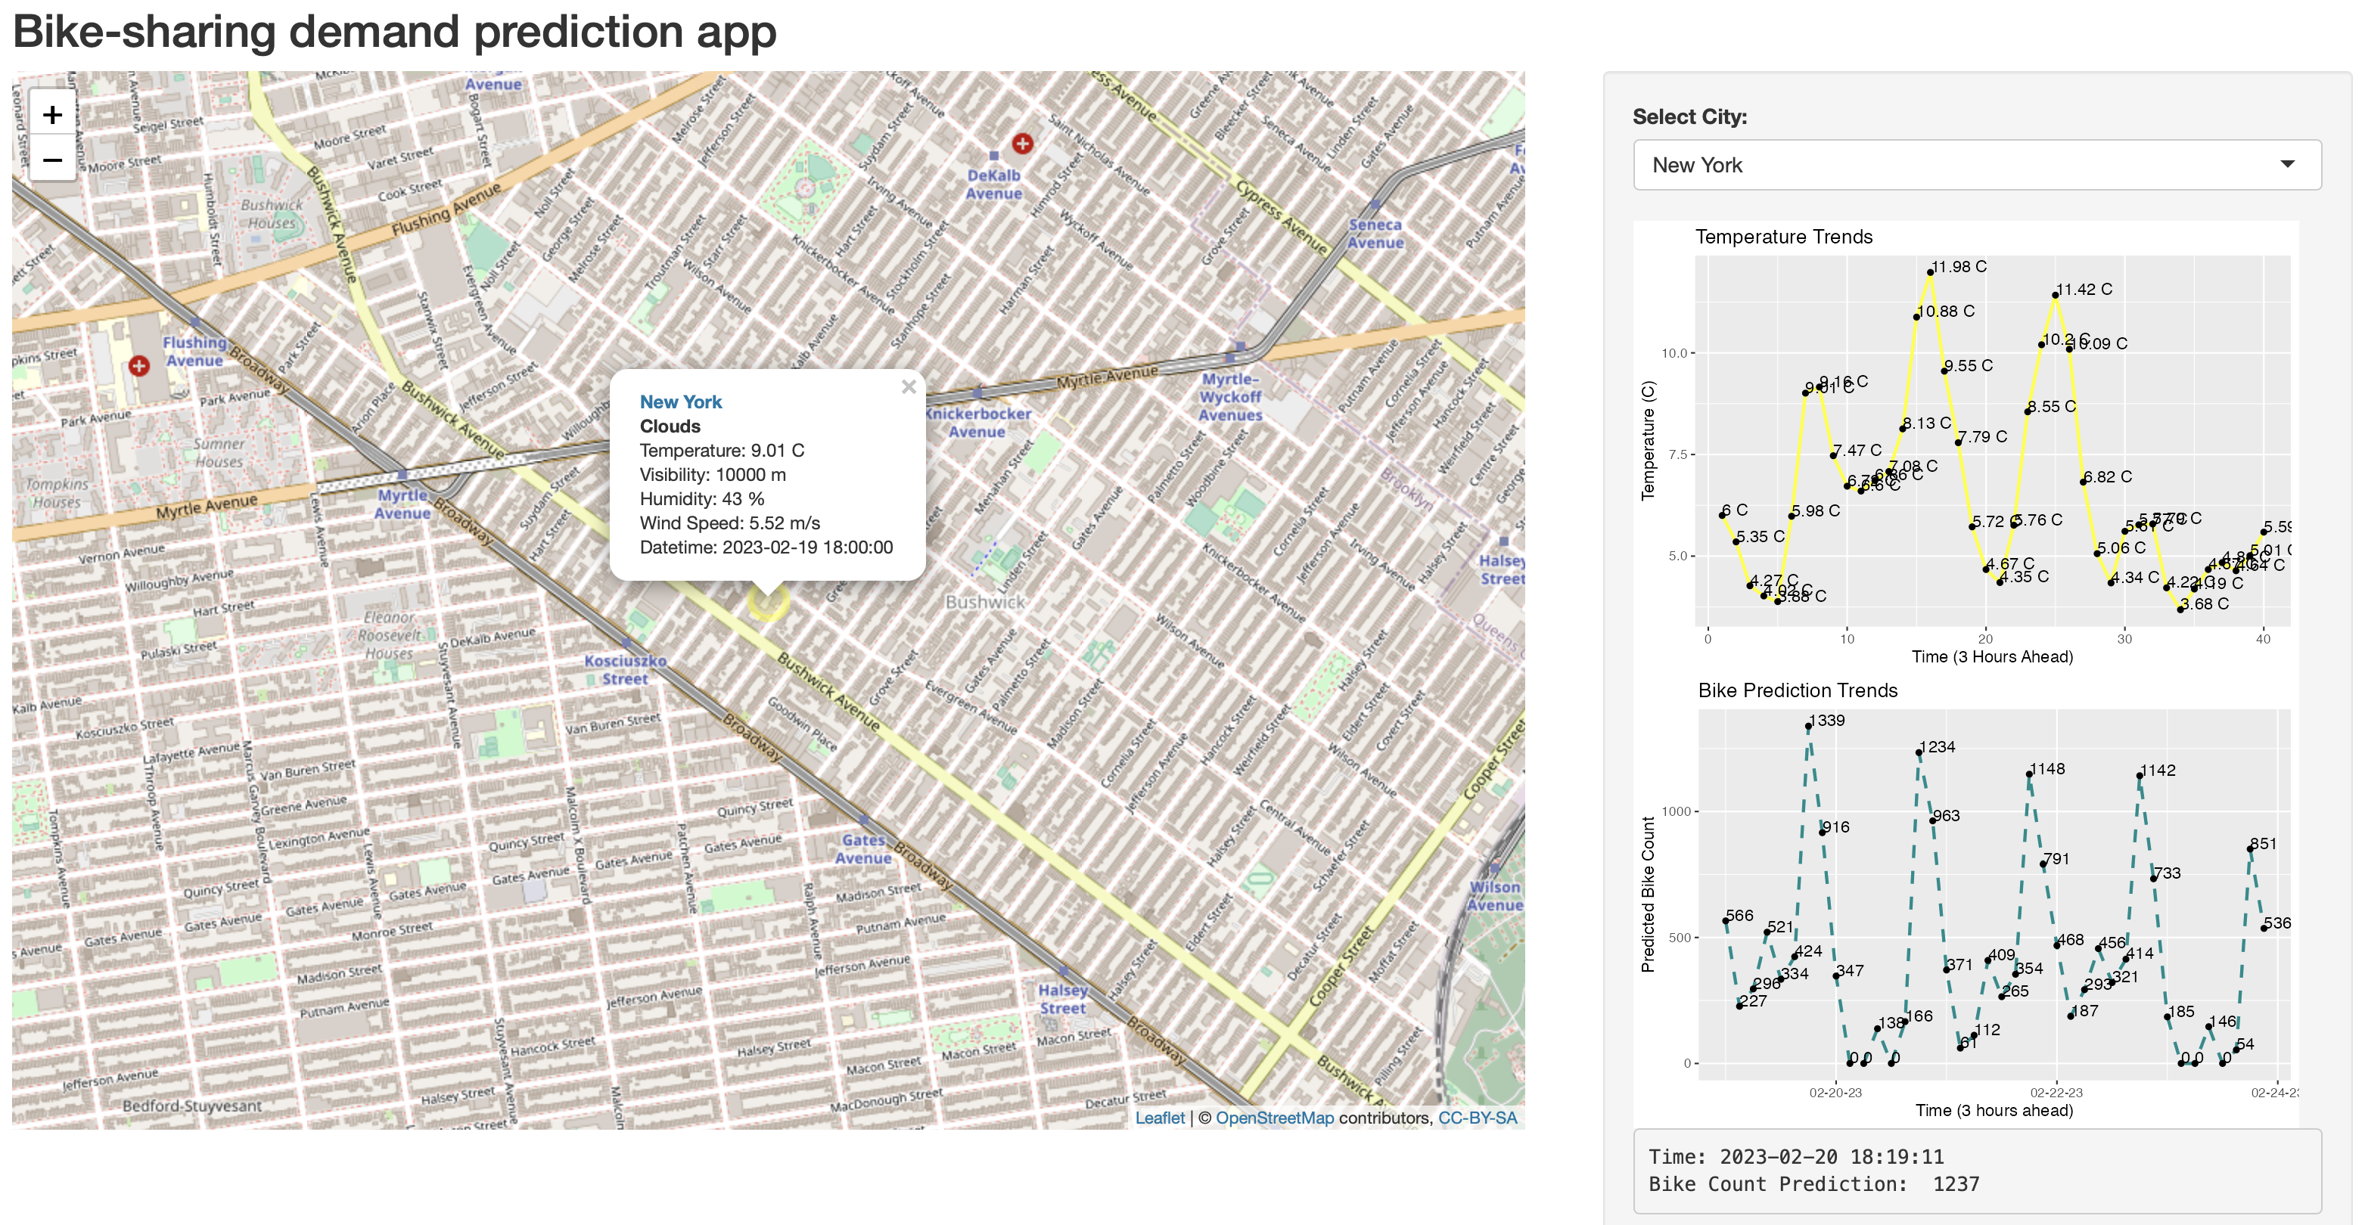
New York Demand Predictions
If you select a city such as New York from the drop down list the map will zoom into the city.
From here you can see current weather conditions for the city, and to the right you can see estimated expected temps.
Below the expected temps are expected demand for bike sharing throughout the city. If you click on one of these points you will notice a time stamp with an estimated prediction based off the current weather conditions of the city selected.

Slide 18
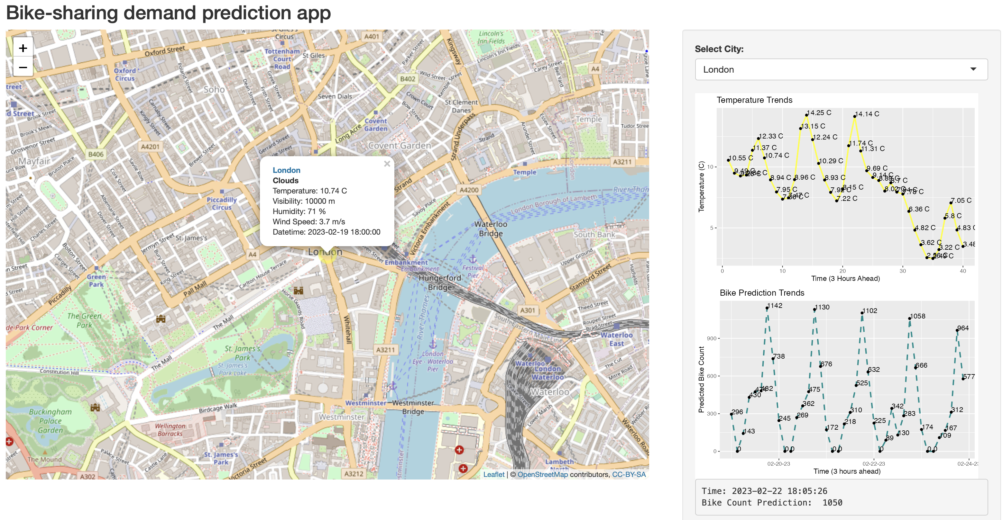
London Predicted Demand
Just like with the New York selected. You can see current weather conditions on the map.
To the right is the estimated temperature for the city and below that is the expected demand based off the current and upcoming weather conditions.

Slide 19

CONCLUSION
In the end we have evaluated thousands of different observations from various relevant and trusted sources. Cleaning, normalizing, and refining this data every step of the way.
We have found the best predictors to be the Season, Temp, Humidity, and Time of day among other less significant factors.
Using the information that we’ve gathered we were able to make multiple plots that compared the relationships these variables have to the demand in bike sharing
With that we were able to create multiple models to handle this data and fine tuned the model to be able to predict expected demand for future use.
We then built a web app for you to use to get a strong estimate at predicting bike demand based on the current weather as well as the predicated weather over the course of the next 5 days.

Slide 20
APPENDIX – Following the Flow of the Presentation…
Wikipedia Source Data Link
Open Weather API (Current Weather Data)
General City Information(General City Information)
Hourly Seoul Bike Sharing Demand Dataset
Data cleansing was done using data filtering relevant columns, and checking for na values, normalizing data ranges, creating clean column titles.
Loading the Data into a Database (With IBM Cloud)
Using dbConnect() to run SQL queries on the Dataset
Query<- (conn, ”select * from…”)
Then visualizing the Results of the Data
Making predictive models and then fine tuning the model for the best predictive accuracy
Using the model to build a web app to display predictive results based off relevant weather information.
Shiny Web Address (Used to publish the Web App)

